Slide 1

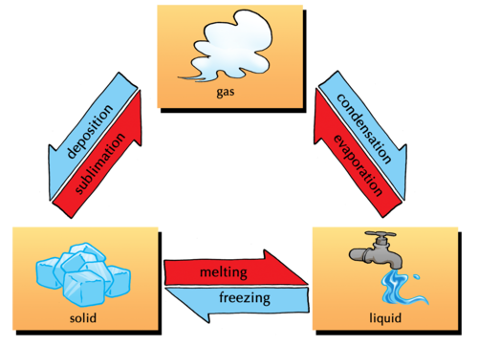
CHANGES IN THE WORLD AROUND US
(CONTINUATION)
CLASS-VII

Slide 2
CHANGE OF STATES
1.EVAPORATION
2.BOILING
3.CONDENSATION
4.DISSOLUTION
5.FREEZING
6.MELTING
7.RUSTING
8.BURNING

Slide 3
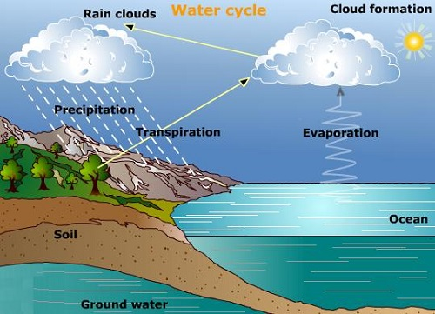
EVAPOURATION
The process in which a liquid changes into vapour.
When heat is supplied to a liquid, the molecules start vibrating with increased speed and the particles in the liquid move in all direction.
This increase in amount of kinetic energy reduces the forces of attraction between the existing molecules and these molecules leave the surface and change into vapour state.
EFFECT ON TEMPERATURE
When temperature is increased, the particles gain more energy, begin to vibrate more rapidly. As a result their tendency to escape increases, so the rate of evaporation increases with increase in temperature.

Slide 4
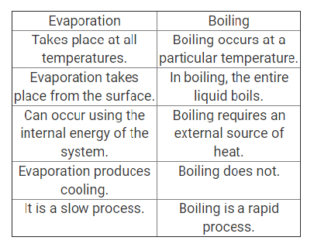
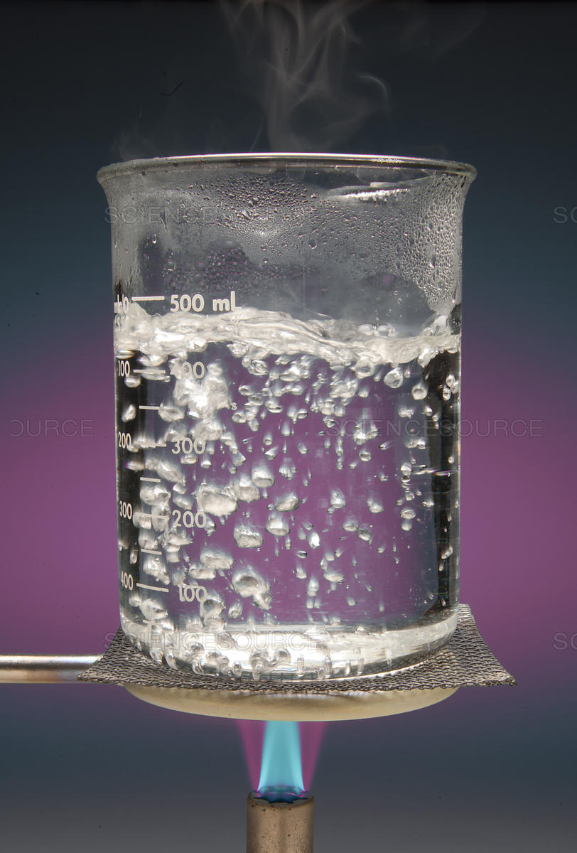
BOILING
The constant temperature at which liquid changes to vapour is known as boiling point and the phenomenon is referred to as boiling.

Slide 5
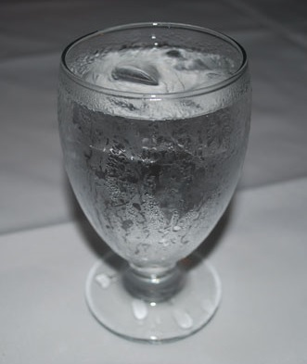
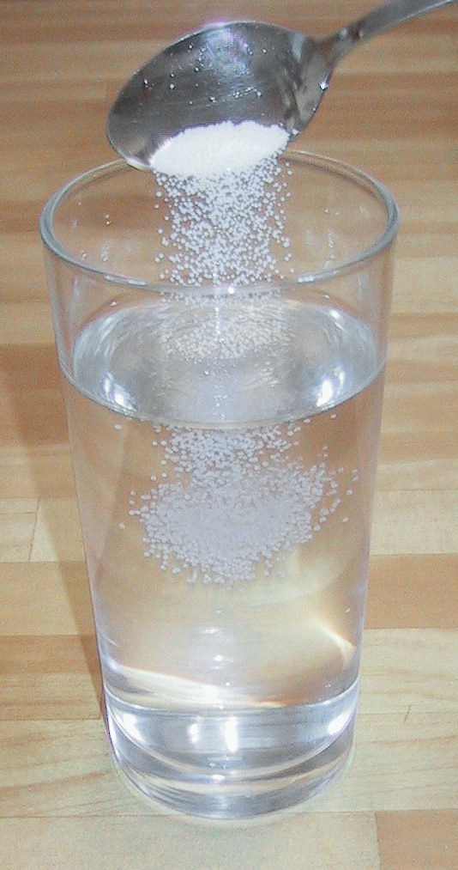
CONDENSATION
The process in which the gas changes to liquid by giving out heat .
DISSOLUTION
The process in which a substance mixes thoroughly in another substance. Example-salt in water
FACTORS AFFECTING DISSOLUTION: 1.TEMPERATURE 2.STIRRING 3.CONCENTRATION OF SOLVENT

Slide 6
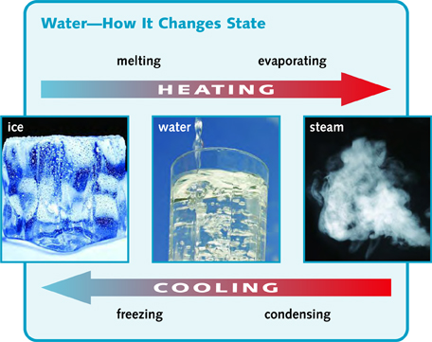
FREEZING
The process in which a liquid substance loses its heat and gets converted into solid states.
MELTING / FUSION
The process in which a solid absorbs heat and gets converted into liquid state.

Slide 7
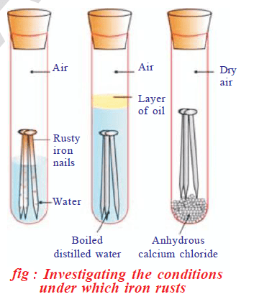
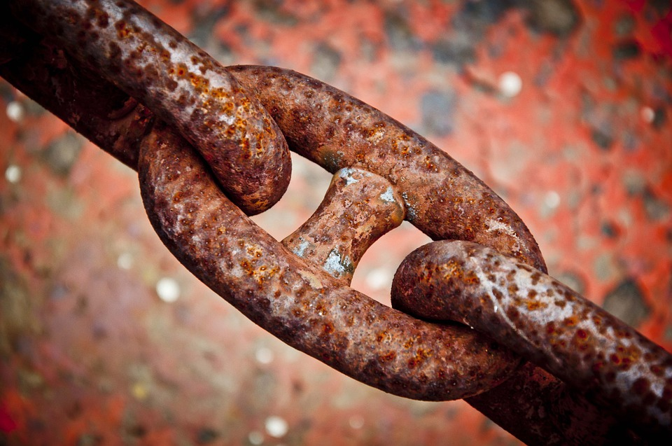
RUSTING
The process in which iron forms a layer of powered iron oxide over it in the presence of air and water is known as rusting.
Also defined as “The slow eating away of metals”

Slide 8
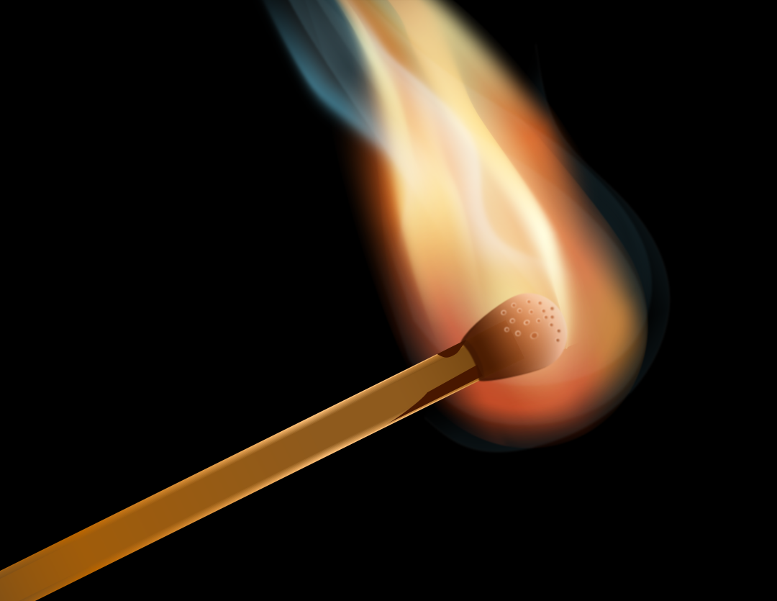
BURNING
The process in which a substance burns in oxygen to give off heat and light.
Thus burning is a fast process and takes place at higher temperature.
SUBSTANCE + OXYGEN
BURN
HEAT
LIGHT

Slide 9
COMPARISON OF RUSTING AND BURNING
RUSTING | BURNING
1.Rusting is a slow process. | 1.Burning is a fast process.
2.Rusting takes place at room temperature. | 2.Burning takes place at higher temperature.
3.Rusting takes place on metal surfaces. | 3.Burning takes place for combustible substances.

Slide 10
COMPARISON OF BURNING AND
RESPIRATION
BURNING | RESPIRATION
1.Burning is a fast process | 1.Respiration is a slow process.
2.Burning takes place at higher temperature. | 2.Respiration takes place at body temperature.
3.Burning takes place for combustible substances. | 3.Respiration take place in living organism.
4.Burning do not involve any enzymes. | 4.Enzymes are biocatalyst and these are required for respiration.

Slide 11
Thank you

